Slide 1

ISyE 4133: Advanced Optimization
Alexander Nathan, Dan That Ton, Qiming (Charlie) Wei, & Priyali Bandla
Notes:
dan

Slide 2
Table of Contents
Problem Statement
Model Formulation
TSP Constraint
Optimized Paths
Sequential Model Formulation
Winning Strategy
Appendix
Notes:
dan

Slide 3
Problem Statement
“The concept of this game is simple: contestants have a specified amount of time to run
through a supermarket and pick up items; upon returning to the starting point, they would
then receive a cash prize based on the total monetary value of the goods they brought back”
Goal:
Highest total monetary value of goods
Rules:
A maximum of 60 seconds for each shopper
It takes 2 seconds to grab an item
Each item can be grabbed once
by both shoppers
Must circle back to their starting point
Shopper travels at a speed of 10 ft/second
Notes:
Charlie Supermarket Sweep was an American television game show that first ran in the 1960s. It was
later brought back in the 1990s. And it was brought back again in the early 2000s. There are even
plans to bring it back in the next few years. The concept of this game was simple: contestants had
a specified amount of time to run through a supermarket and pick up items; upon returning to the
starting point, they would then receive a cash prize based on the total monetary value of the goods
they brought back.
For most contestants on the show, strategies were simple. Some would run straight for the most
expensive items; others would choose a path that allowed them to collect as many items as possible,
regardless of value. For this project, you will model the problem of optimally filling up two baskets
for a team of two contestants.

Slide 4
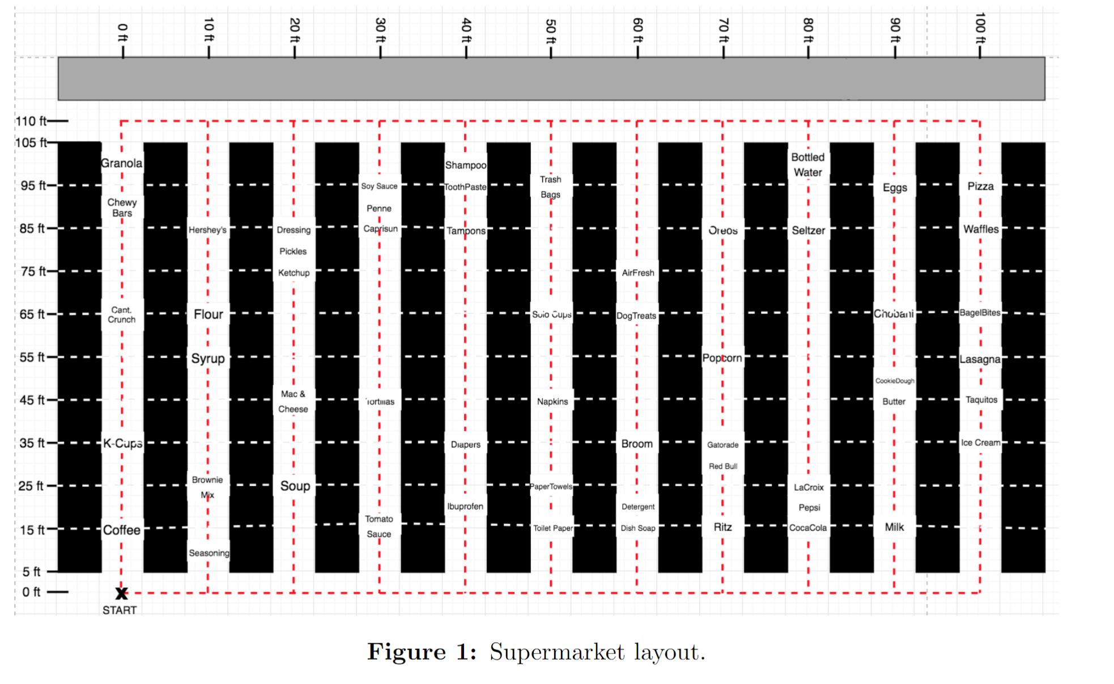
Layout
Total Vertical Distance: 110 ft
Only allowed to move horizontally between the start and end of shelves
Total Horizontal Distance: 100 ft
Notes:
Charlie

Slide 5
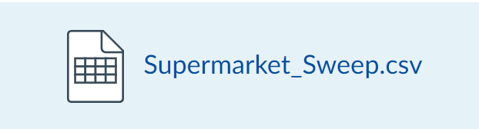
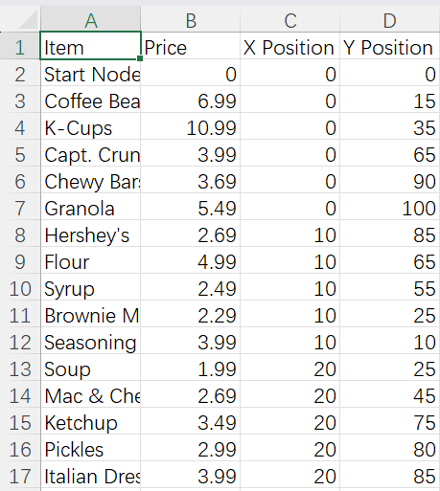
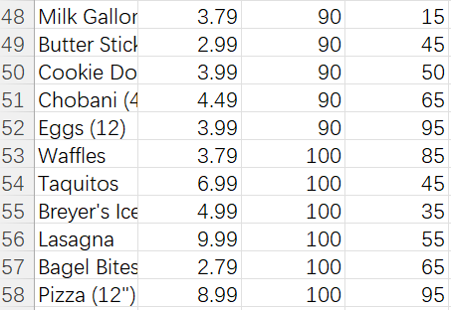
Data
Item: Name of item
Price: Price of item
X Position: The vertical distance from the starting point to the item (In fts)
Y Position: The horizontal distance from the starting point to the item (In fts)
Total of 56 Items
Starting Point has a price of 0
Notes:
Charlie

Slide 6
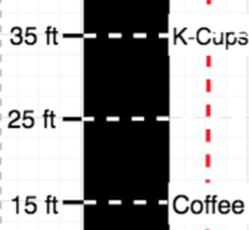
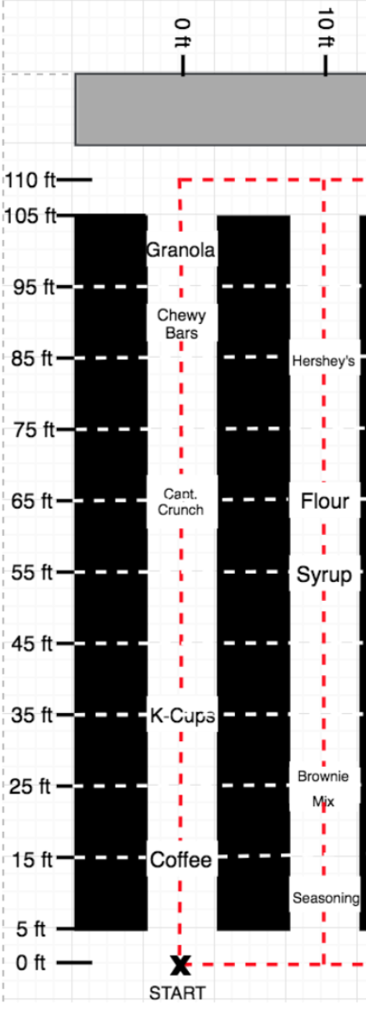
Calculating the Shortest Time between Items
Shortest distance = |35-15| = 20 ft
= 2 sec
If the items have the same x-coordinate:
Shortest time = |y1-y2|/10
If the items do not have the same x-coordinate:
Shortest time = [min(sum(y1+y2),
220-sum(y1+y2))+|x1-x2|] / 10
From K-Cups To Flour
We want to pick the minimum y distance out of two choice (Orange and grey)
In this case 35+55=90 < 220-(35+55)=130
We add this y distance to x distance take to get shortest distance (90+10=100 ft =10 sec)
Notes:
Charlie

Slide 7
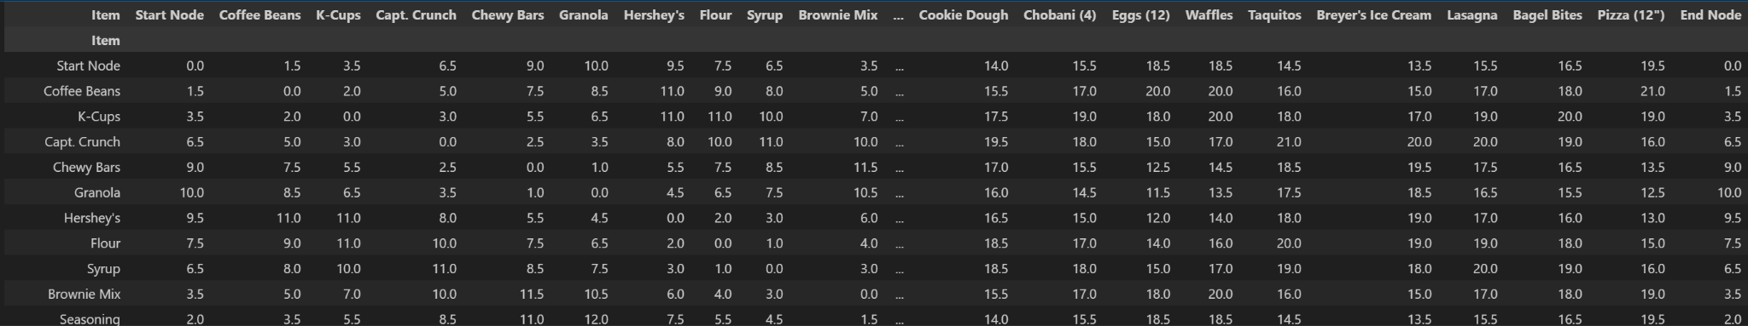
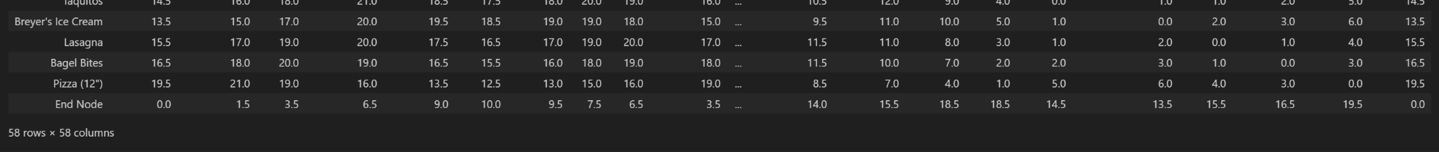
Shortest Time Matrix
Notes:
Charlie

Slide 8
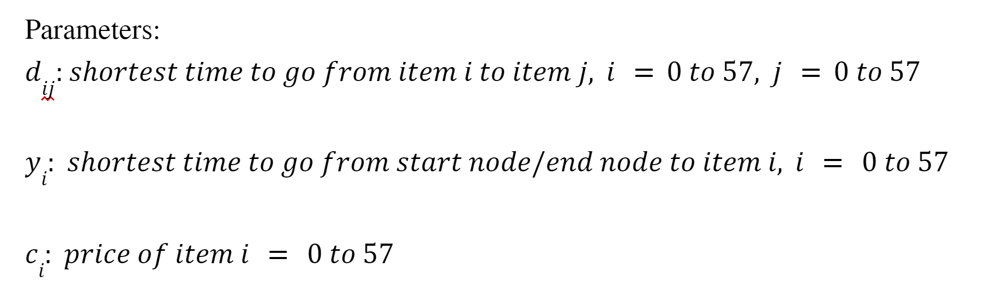
Model Formulation - Parameters
From The Shortest Time Matrix
From the Provided CSV
Notes:
dan

Slide 9
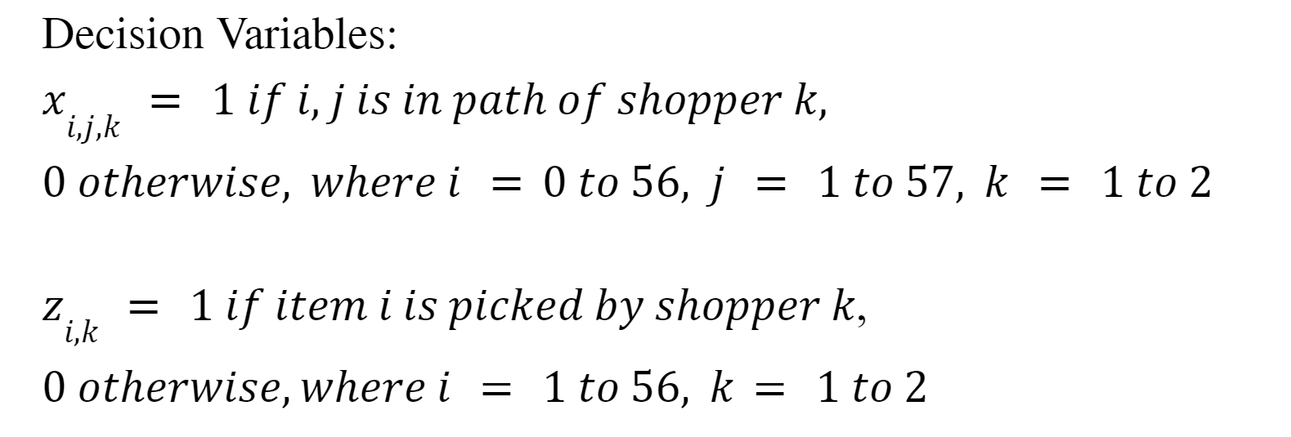
Model Formulation - Variables
Notes:
dan

Slide 10
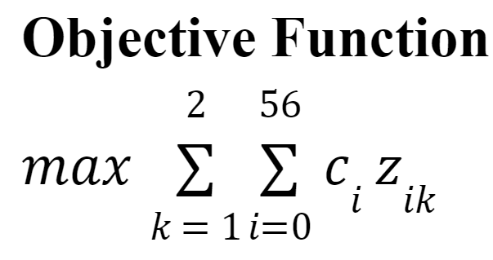
Model Formulation - Objective Function
Notes:
dan

Slide 11
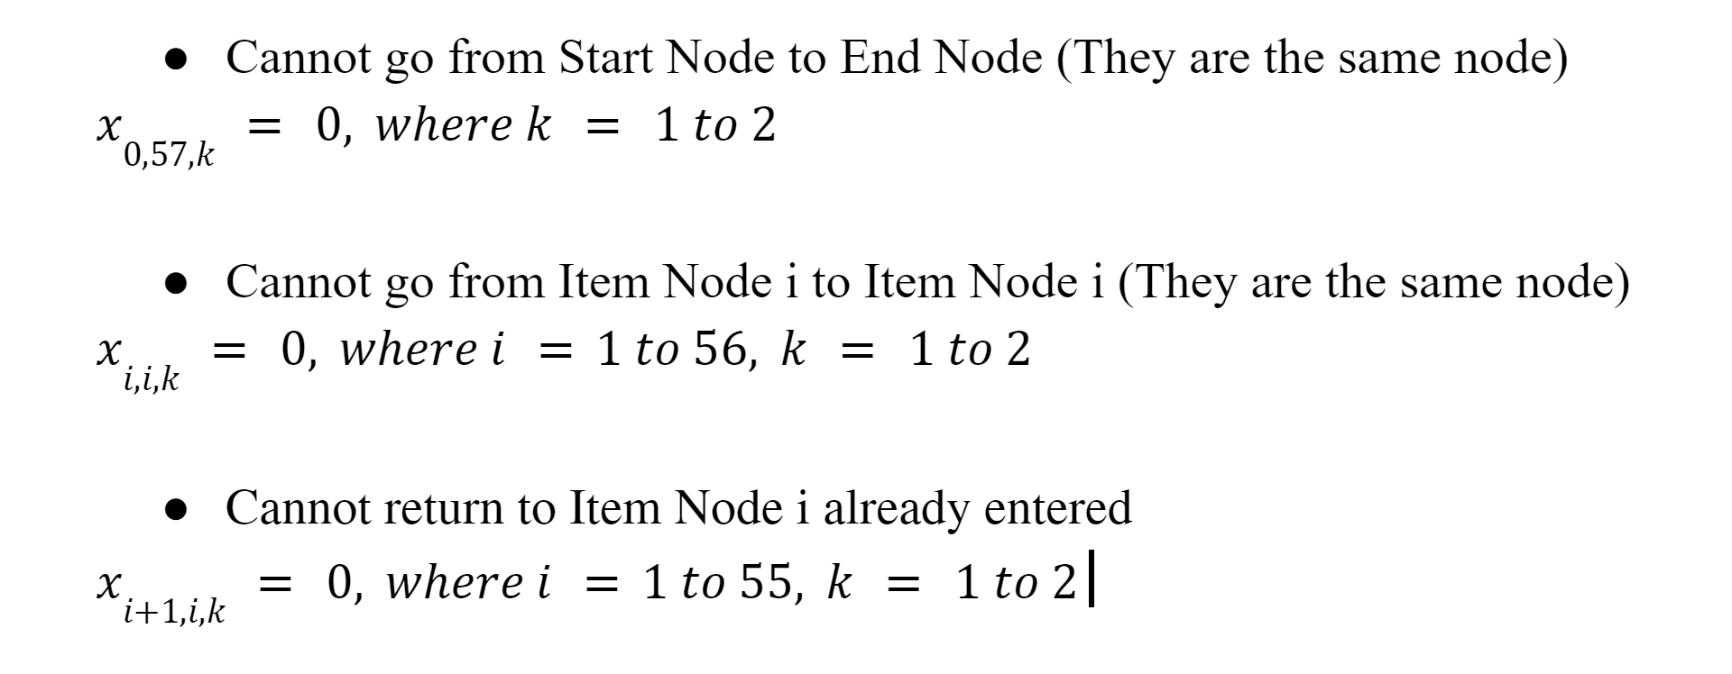
Model Formulation - Constraints
Notes:
nathan

Slide 12
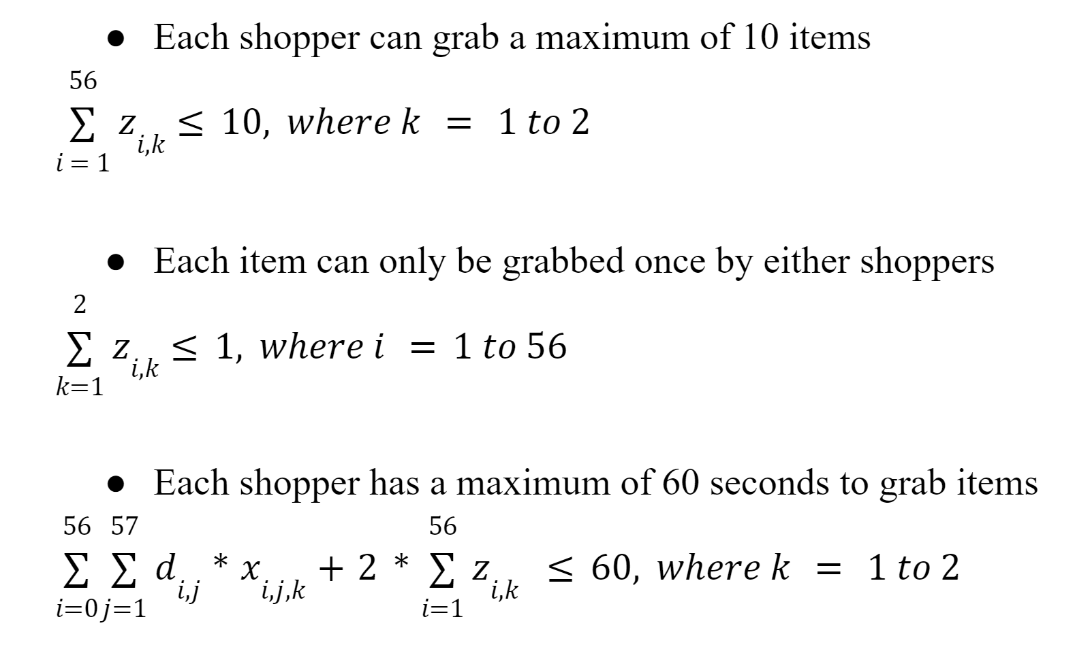
Model Formulation - Constraints
Notes:
nathan

Slide 13
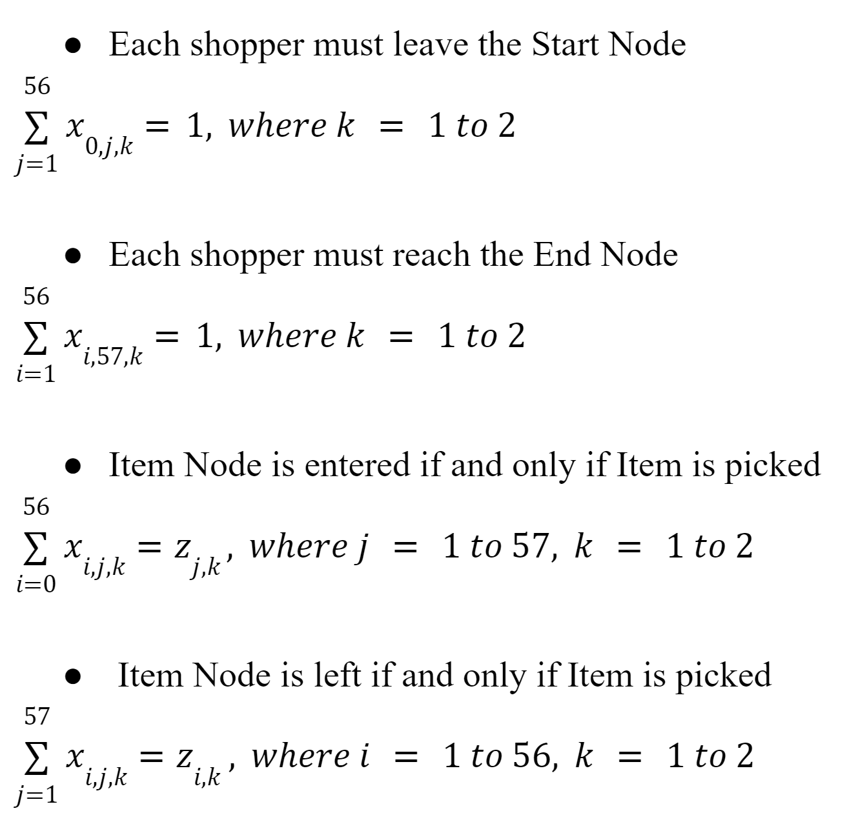
Model Formulation - Constraints
Notes:
nathan

Slide 14
TSP Optimized Paths
Optimal Path for Shopper 2:
(Start, 1) → (1, 2) → (2, 21) → (21, 22) → (22, 25) → (25, 29) → (29, 30) → (30, 35) → (35, 38) → (38, 39)→(39, End)
Items Chosen for Shopper 2:
[Coffee Beans, K-Cups, Ibuprofen, Diapers, Shampoo, Solo Cups, Trash Bags, Air Freshener,
Gatorade (12), Redbull (4)]
Total Value for Shopper 2: $83.39
Optimal Path for Shopper 1:
(Start, 26) → (26, 27) → (27, 32) → (32, 33) → (33, 41) → (41, 42) → (42, 43) → (43, 52) → (52, 54) → (54, 56) → (56, End)
Items Chosen for Shopper 1:
[Toilet Paper, Paper Towels, Detergent, Broom, Coca Cola (12), LaCroix (12), Pepsi (12), Taquitos, Lasagna,
Pizza (12")]
Total Value for Shopper 1: $81.19
Total Value of both shoppers: $164.60
Notes:
nathan

Slide 15
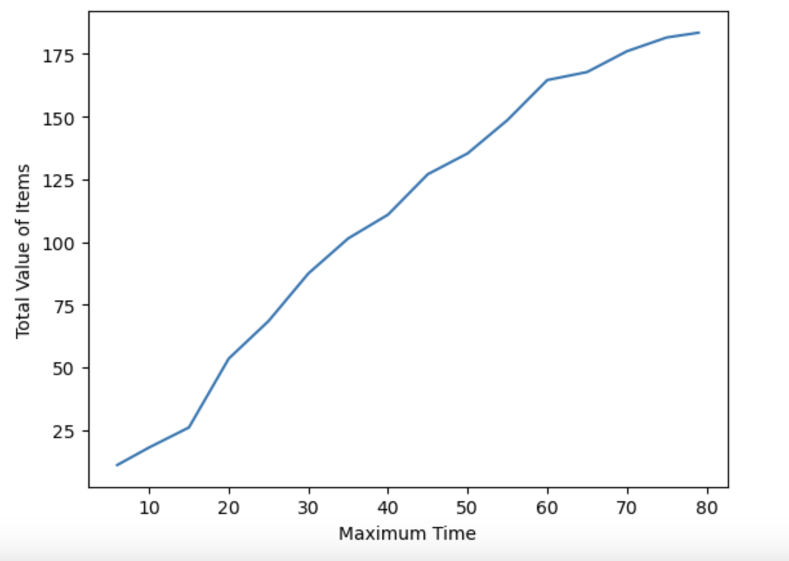
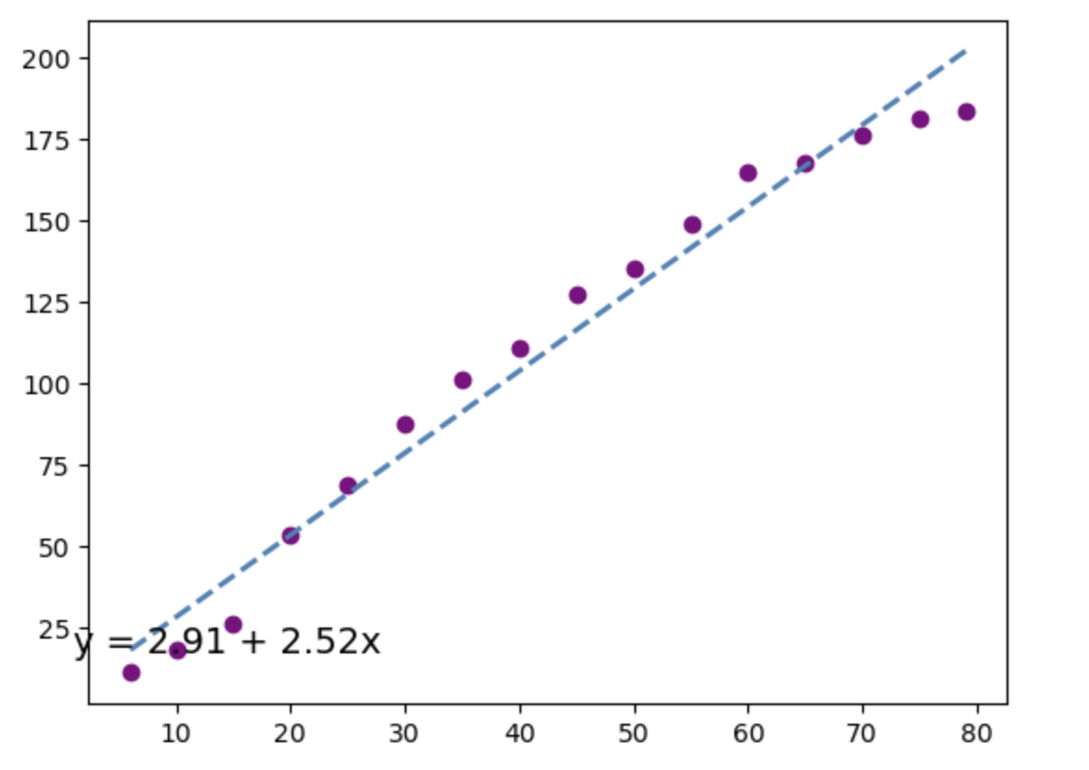
Different Time Limits
There is a positive, almost linear trend between maximum time and total value of items
Notes:
Nathan The general trend is that as the maximum time increases, so does the total value of items, and vice versa. Further analysis of plot A shows a nearly straight line representing that of a linear equation relating the maximum time and the total value of items.

Slide 16
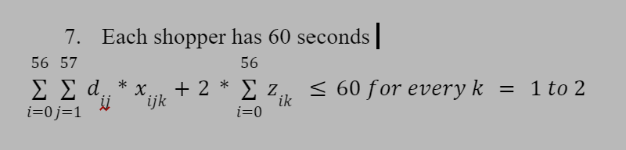
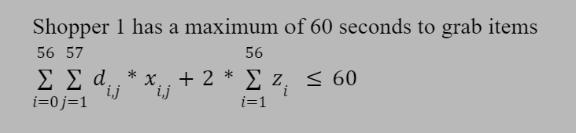
Sequential Model - Formulation
Simultaneous
Optimal Path for Shopper 1:
(Start, 1) → (1, 2) → (2, 10) → (10, 21) → (21, 22) → (22, 26) → (26, 27) → (27, 31) → (31, 32)
→ (32, 33)→ (33, End)
Items Chosen for Shopper 1:
[Coffee Beans, K-Cups, Seasoning, Ibuprofen, Diapers, Toilet Paper, Paper Towels, Dish Soap, Detergent, Broom]
Total Value for Shopper 1: $101.40
Sequential
Notes:
priyali

Slide 17
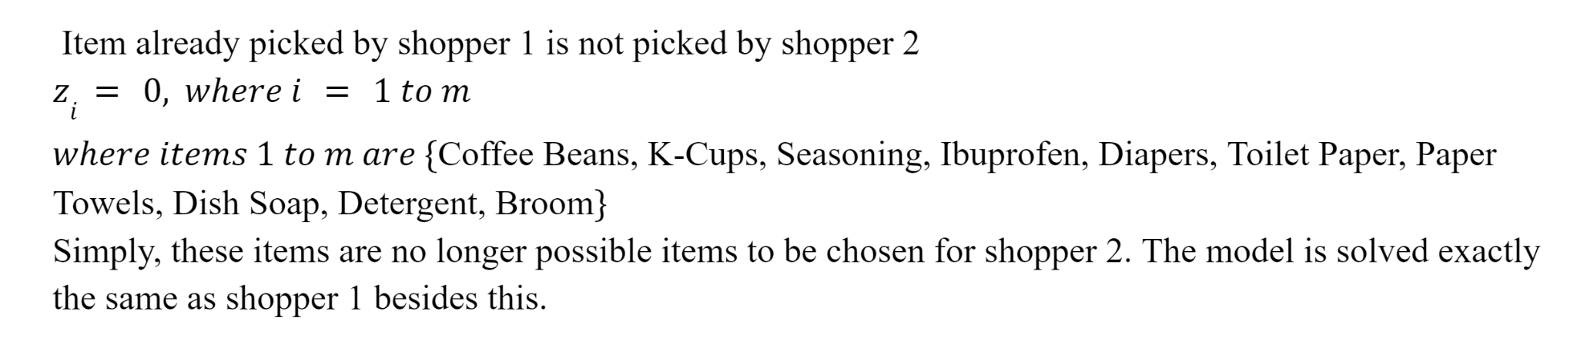
Constraints for Shopper 2
Notes:
priyali

Slide 18
Sequential Model Formulation
Optimal Path for Shopper 1:
(Start, 1) → (1, 2) → (2, 10) → (10, 21) → (21, 22) → (22, 26) → (26, 27) → (27, 31) → (31, 32)
→ (32, 33)→ (33, End)
Items Chosen for Shopper 1:
[Coffee Beans, K-Cups, Seasoning, Ibuprofen, Diapers, Toilet Paper, Paper Towels, Dish Soap, Detergent, Broom]
Total Value for Shopper 1: $101.40
Optimal Path for Shopper 2:
(Start, 3) → (3, 5) → (5, 23) → (23, 25) → (25, 30) → (30, 36) → (36, 38) → (38, 39) → (39, 40) → (40, End)
Items Chosen for Shopper 2:
[Capt. Crunch, Granola, Toothpaste, Shampoo, Trash Bags, Oreos, Gatorade (12), Redbull (4), Ritz]
Total Value for Shopper 2: $54.41
Total Value of both shoppers: $155.81
Notes:
priyali

Slide 19
Winning Strategy
Our TSP (b) was the best strategy
Simultaneous: $164.60
Sequential: $155.81
Had a difference of $8.79 over sequential model
This was in agreement with our original hypothesis that modelling the shoppers traversing simultaneously would be better
Notes:
priyali

Slide 20
Q & A
Thank you!
Notes:
priyali

